Slide 1
ASSEMBLY LANGUAGE (WEEK-4)

Slide 2
Logical Operations
AND
XOR
ROL
RCR
OR
SHL
ROR
TEST
SHR
RCL

Slide 3
AND
Performs bitwise AND operation
Instruction format: AND DEST, SRC
Equivalent operation: DEST = DEST AND SRC
Example: AND AL, 3
Equivalent operation: AL = AL AND 3
Restrictions:
Number of bits (SRC) = Number of bits (DEST)
SRC and DEST can not be variables at a time

Slide 4
AND
Working Principle:
128
64
32
16
8
4
2
1
Let AL = 189d
1
0
1
1
1
1
0
1
8
4
2
1
8
4
2
1
Let BL = 0D3h
1
1
0
1
0
0
1
1
AL AND BL
1
0
0
1
0
0
0
1
AL in decimal
145d
AL in Hexa
91h

Slide 5
OR
Performs bitwise OR operation
Instruction format: OR DEST, SRC
Equivalent operation: DEST = DEST OR SRC
Example: OR AL, 3
Equivalent operation: AL = AL OR 3
Restrictions:
Number of bits (SRC) = Number of bits (DEST)
SRC and DEST can not be variables at a time

Slide 6
OR
Working Principle:
128
64
32
16
8
4
2
1
Let AL = 213d
1
1
0
1
0
1
0
1
8
4
2
1
8
4
2
1
Let BL = 9h
0
0
0
0
1
0
0
1
AL OR BL
1
1
0
1
1
1
0
1
AL in decimal
221d
AL in Hexa
0DDh

Slide 7
XOR
Performs bitwise XOR operation
Instruction format: XOR DEST, SRC
Equivalent operation: DEST = DEST XOR SRC
Example: XOR AL, 3
Equivalent operation: AL = AL XOR 3
Restrictions:
Number of bits (SRC) = Number of bits (DEST)
X
Y
F
SRC and DEST can not be variables at a time
0
0
0
1
0
1
Special Properties of XOR:
0
1
1
X XOR 0 = X
1
1
0
X XOR 1 = X

Slide 8
XOR
Working Principle:
128
64
32
16
8
4
2
1
Let AL = 213d
1
1
0
1
0
1
0
1
8
4
2
1
8
4
2
1
Let BL = 9h
0
0
0
0
1
0
0
1
AL XOR BL
1
1
0
1
1
1
0
0
AL in decimal
220d
AL in Hexa
0DCh

Slide 9
SET A BIT
8
7
6
5
4
3
2
1
Set the 4th bit of AL to 1 and keep other bits unchanged
Consider AL:
a
b
c
d
e
f
g
h
Bitwise OR with:
0
0
0
0
1
0
0
0
a
b
c
d
1
f
g
h

Slide 10
RESET A BIT
8
7
6
5
4
3
2
1
Set the 5th bit of AL to 0 and keep other bits unchanged
Consider AL:
a
b
c
d
e
f
g
h
Bitwise AND with:
1
1
1
0
1
1
1
1
a
b
c
0
e
f
g
h

Slide 11
COMPLEMENT/CHANGE A BIT
8
7
6
5
4
3
2
1
Complement the 5th bit of AL and keep other bits unchanged
Consider AL:
a
b
c
d
e
f
g
h
Bitwise XOR with:
0
0
0
1
0
0
0
0
a
b
c
d
e
f
g
h

Slide 12
COMPLEMENT A REGISTER
8
7
6
5
4
3
2
1
Consider AL:
a
b
c
d
e
f
g
h
Complement all the bits of AL
Bitwise XOR with:
1
1
1
1
1
1
1
1
a
b
c
d
e
f
g
h

Slide 13
CHECK ODD/EVEN
Check whether the value stored in AL is even or odd
8
7
6
5
4
3
2
1
Consider AL:
a
b
c
d
e
f
g
h
h is 0 if AL is even, h is 1 if AL is odd
Bitwise AND with:
0
0
0
0
0
0
0
1
AL:
0
0
0
0
0
0
0
h
If h=1, then AL=1, means AL is odd
If h=0, then AL=0, means AL is even
CMP AL,1
JE ODD
JNE EVEN

Slide 14
TEST
Performs bitwise AND operation
Instruction format: TEST A, B
Difference with AND is it doesn’t store the resultant value
But it changes the value of Zero Flag
If the resultant value is 0, it sets the Zero Flag to 1, else 0
Equivalent operation: TEST A,B means if A AND B is 0 then Z=1, else Z=0
Restrictions:
Number of bits (A) = Number of bits (B)
A and B can not be variables at a time

Slide 15
TEST EXAMPLE
8
7
6
5
4
3
2
1
Consider A:
0
1
1
0
1
1
0
1
Consider B:
1
0
0
0
0
0
1
0
A AND B:
0
0
0
0
0
0
0
0
Result is 0
So, Z will be set to 1

Slide 16
TEST EXAMPLE
8
7
6
5
4
3
2
1
Consider A:
0
1
1
0
1
1
0
1
Consider B:
1
1
0
0
0
0
1
1
A AND B:
0
1
0
0
0
0
0
1
Result is 65 (Not Zero)
So, Z will be set to 0

Slide 17
CHECK A BIT
8
7
6
5
4
3
2
1
Check whether the 4th bit of AL is 0 or 1
Consider AL:
a
b
c
d
e
f
g
h
TEST AL with:
0
0
0
0
1
0
0
0
TEST result:
0
0
0
0
e
0
0
0
If 4th bit (e) is 1, then Test result is not Zero, means Z=0
If 4th bit (e) is 0, then Test result is Zero, means Z=1
TEST AL,00001000b
JZ Fourth_Bit_Is_Zero
JNZ Fourth_Bit_Is_One

Slide 18
CHECK ODD/EVEN
Check whether the value stored in AL is even or odd
8
7
6
5
4
3
2
1
Consider AL:
a
b
c
d
e
f
g
h
TEST AL with:
0
0
0
0
0
0
0
1
TEST Result:
0
0
0
0
0
0
0
h
TEST AL,1
JZ EVEN
JNZ ODD

Slide 19
SHIFT LEFT
Performs bitwise Left Shift operation
Instruction format: SHL A, B
Shifts A for B number of times at left
Stores the MSB at Carry Flag (CF) after one left shift
Restrictions:
B must be value or CL

Slide 20
SHIFT LEFT
8
7
6
5
4
3
2
1
Consider BL:
a
b
c
d
e
f
g
h
SHL BL,1:
a
b
c
d
e
f
g
h
0
CF
BL
0

Slide 21
SHIFT LEFT
8
7
6
5
4
3
2
1
Consider BL:
a
b
c
d
e
f
g
h
SHL BL,1:
b
c
d
e
f
g
h
0
Again SHL BL,1:
b
c
d
e
f
g
h
0
0
CF
BL
0

Slide 22
SHIFT LEFT
Maximum how many Left Shift operation needed for setting a n-bit register to 0?
n
Write a code that sets BL to 0 by Left Shift operation
First Way:
Second Way:
Wrong Way:
SHL BL,8
MOV CL,8
MOV AL,8
SHL BL,CL
SHL BL,AL
Write a code for printing the binary value of a 8 bit register/variable

Slide 23
SHIFT RIGHT
Performs bitwise Right Shift operation
Instruction format: SHR A, B
Shifts A for B number of times at right
Stores the LSB at Carry Flag (CF) after one right shift
Restrictions:
B must be value or CL

Slide 24
SHIFT RIGHT
8
7
6
5
4
3
2
1
Consider BL:
a
b
c
d
e
f
g
h
SHR BL,1:
0
a
b
c
d
e
f
g
h
BL
CF
0

Slide 25
ROTATE LEFT
Performs bitwise Left Roate operation
Instruction format: ROL A, B
Rotate A for B number of times at left
Stores the MSB at Carry Flag (CF) and at LSB after one left rotate
Restrictions:
B must be value or CL

Slide 26
ROTATE LEFT
8
7
6
5
4
3
2
1
Consider BL:
a
b
c
d
e
f
g
h
ROL BL,1:
a
b
c
d
e
f
g
h
a
CF
BL

Slide 27
ROTATE LEFT
Let X is a 2 bit register, Rotate it for 2 times (left/right), And then write down the observation
A:
a
b
ROL AL,1:
b
a

Slide 28
ROTATE LEFT
Let X is a 2 bit register, Rotate it for 2 times (left/right), And then write down the observation
A:
a
b
The initial value gets restored if a n-bit register/memory is rotated(left/right) for n times
ROL AL,1:
b
a
Write down the advantages of printing the binary value of a register/variable using rotate operation rather than using shift operation.
ROL AL,1:
a
b

Slide 29
ROTATE RIGHT
Performs bitwise Right Roate operation
Instruction format: ROR A, B
Rotate A for B number of times at right
Stores the LSB at Carry Flag (CF) and at MSB after one left rotate
Restrictions:
B must be value or CL

Slide 30
SHIFT RIGHT
8
7
6
5
4
3
2
1
Consider BL:
a
b
c
d
e
f
g
h
SHR BL,1:
h
a
b
c
d
e
f
g
h
BL
CF

Slide 31
ROTATE CARRY LEFT
8
7
6
5
4
3
2
1
Consider BL:
a
b
c
d
e
f
g
h
RCL BL,1:
a
b
c
d
e
f
g
h
i
i
CF
BL
ROTATE CARRY RIGHT will be in same way

Slide 32
QUESTIONs
We XOR 32 with a letter for converting it from uppercase to lowercase or lowercase to uppercase. Why?
One time Left shift of a register/variable results into a multiplication by 2, do you agree?
n time Left shift of a register/variable results into a multiplication by 2^{n}, do you agree? [n<8]
Set the value of Al register as 0, using only XOR operation. MOV can not be used

Slide 33
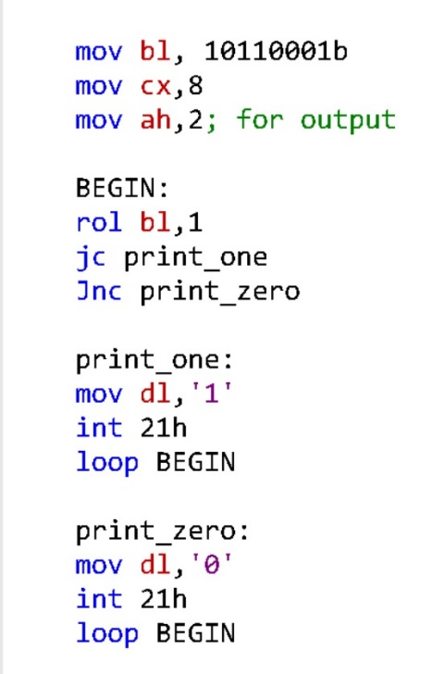
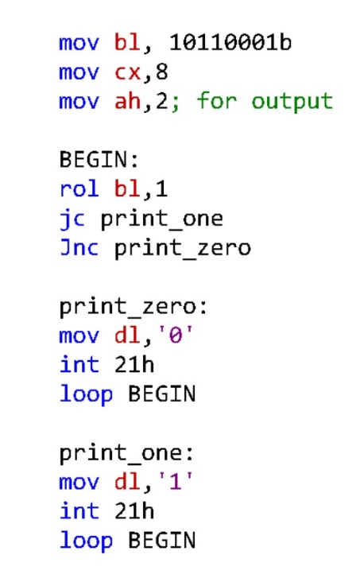
QUESTIONs
Only difference between Code-1 and Code-2 is that sequence of writing the labels “print_one” and “print_zero” are swapped. But Code-1 will execute for infinite times and Code-2 will execute as expected (8 times). Explain this fact.
Code-1
Code-2

